Slide 1
INDIAN PREMIER LEAGUE “IPL”
By,
Srilakshmi K B
LIBA -Executive Post Graduate Program in BA
Upgrad MAY – 2023-24 batch

Slide 2
ABOUT IPL
The IPL was inaugurated in 2008 as a professional Twenty20 cricket league in India.
It is a franchise-based league, with teams representing different cities or regions.
The IPL follows a round-robin group stage followed by playoffs, with the top teams competing for the championship.
Teams participate in an annual auction to buy players from around the world, making it a truly international league.
IPL has attracted top international and Indian cricketers, becoming a platform for young talent.
It has a significant economic impact on Indian cricket and the entertainment industry.
Several records, including highest run-scorer and highest wicket-taker, have been set and broken in the IPL.
The IPL continues to be a major sporting event in India and a key fixture on the global cricket calendar

Slide 3
TEAMS IN IPL
❑ Chennai Super Kings (CSK)
❑ Mumbai Indians (MI)
❑ Royal Challengers Bangalore (RCB)
❑ Kolkata Knight Riders (KKR)
❑ Kings XI Punjab (KXIP)
❑ Rajasthan Royals (RR)
❑ Delhi Daredevils (later renamed Delhi Capitals)
❑ Deccan Chargers

Slide 4
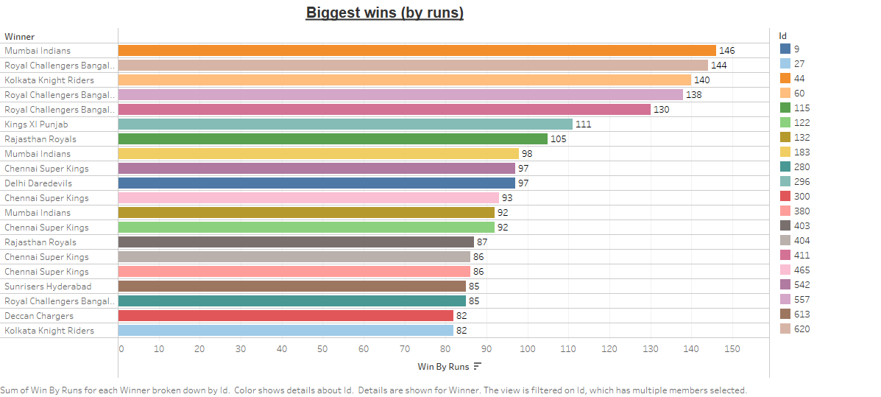
It represents Biggest Wins by Runs which shows that Mumbai Indians has had the biggest wins by runs.

Slide 5
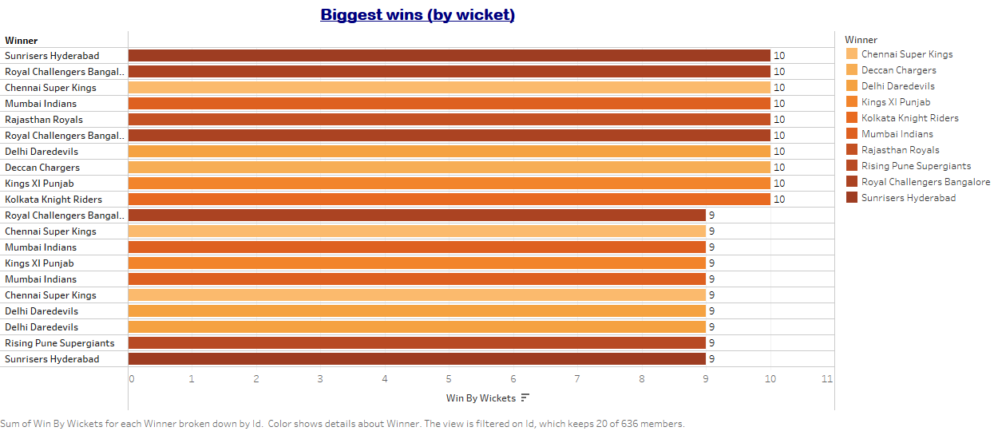
It represents Biggest Wins by Wickets which shows that Sun risers Hyderabad has had the biggest wins by wickets.

Slide 6
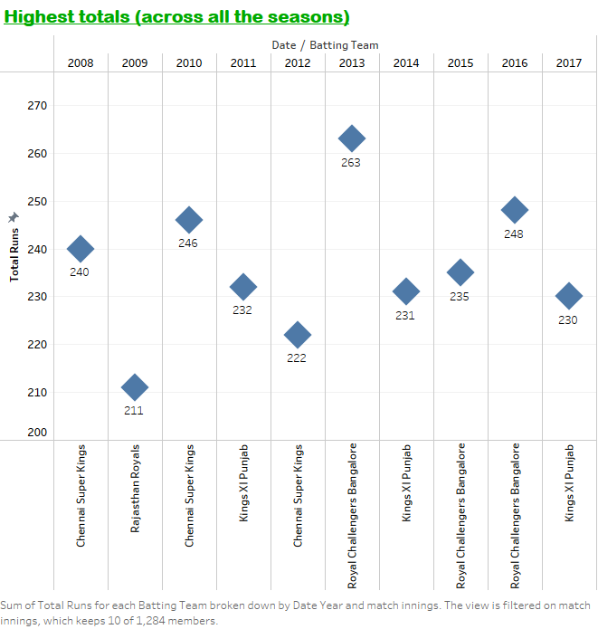
It also provides us with the information of Highest totals across all the seasons by different teams.

Slide 7
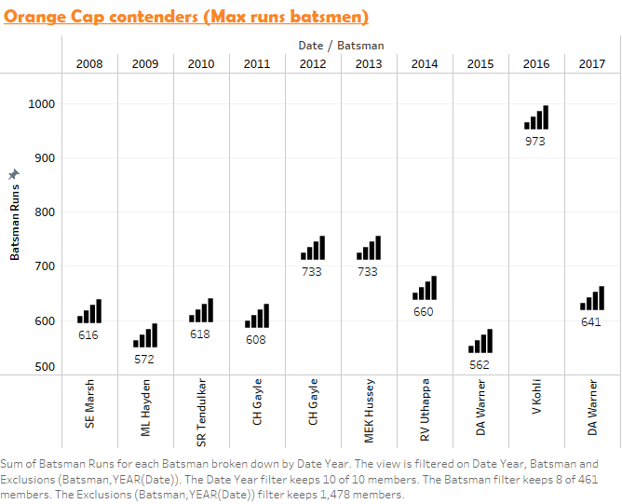
Maximum runs scored by individual batsmen in each and every year

Slide 8
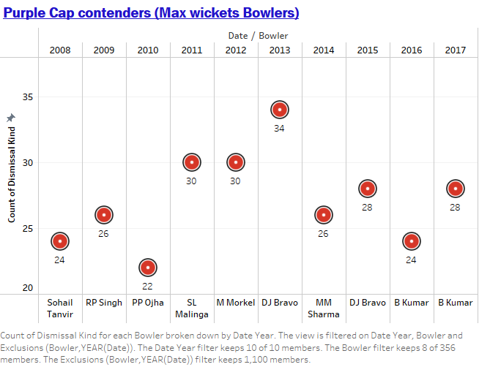
Purple Cap contenders i.e, who took most wickets, across all the seasons.

Slide 9
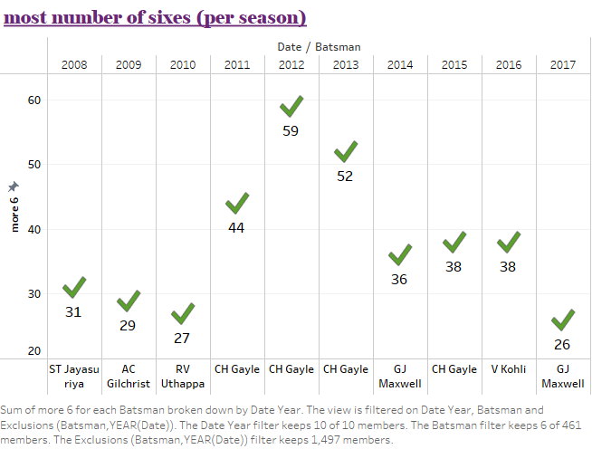
CH Gayle hit the most Sixes as well as the overall

Slide 10
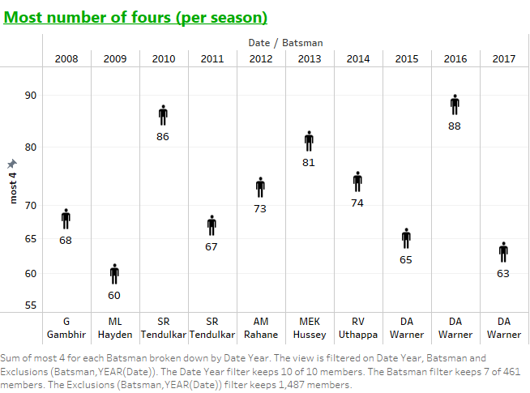
DA Warner hit the most Fours.

Slide 11
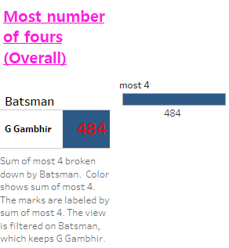
In the IPL, from 2008-2017,He scored highest 4’s.

Slide 12
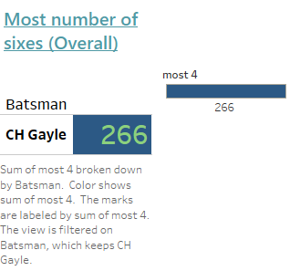
In the IPL, from 2008-2017,He scored highest 6’s all seasons put to gather.

Slide 13
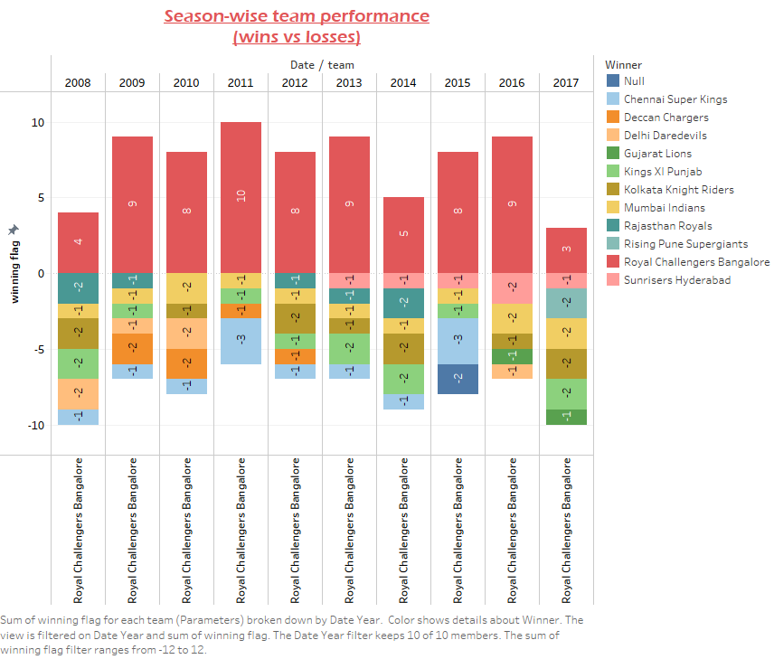
The Team Statistics shows Season wise Team Performance.

Slide 14
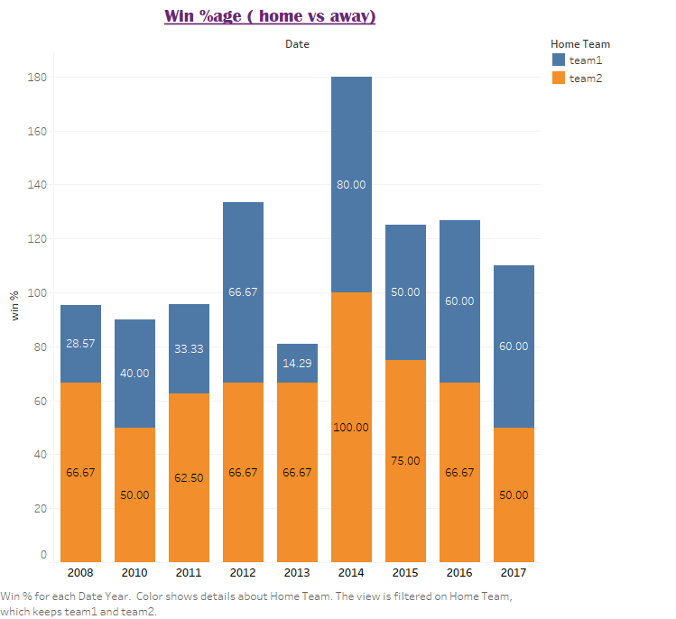
Win percentage and Home Ground and away. It shows Mumbai Indians won maximum times in 2013. It shows us the winning percentage of different teams when they are on their home ground and when they are not at their home ground being mentioned as away.

Slide 15
Summary
The IPL Data Visualization gives us information about the various teams of IPL. It helps us to understand the performance of various teams across all the seasons.
We saw the Orange cap contenders and Purple cap contenders.
Mumbai Indians have been the most successful team in IPL history, with multiple championships. They have consistently made the playoffs and have a strong core of players. Led by Rohit Sharma, MI is known for its balanced squad and adaptability to various conditions.
CSK is another highly successful IPL team with a reputation for consistency. Led by MS Dhoni, they have won multiple championships and made numerous playoff appearances.
RCB has consistently been a competitive team but has not won an IPL championship
KKR, co-owned by ShahRukhKhan, has enjoyed success, including IPL titles
RR won the inaugural IPL but has had mixed performances since
SRH, a relatively new team, has had significant success, including an IPL championship. David Warner's captaincy and batting have been influential.

Slide 16
Thank you.

